Slide 1
Power BI Installation

Slide 2
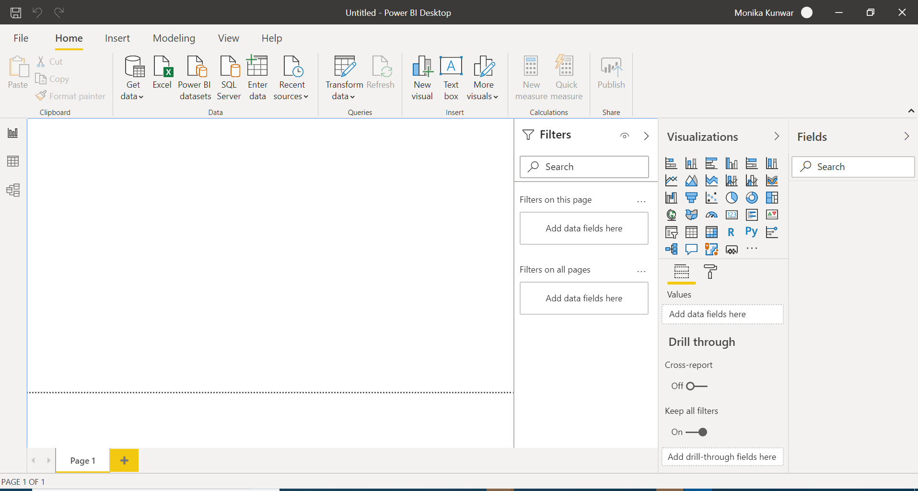
Screen shot of Report view page

Slide 3
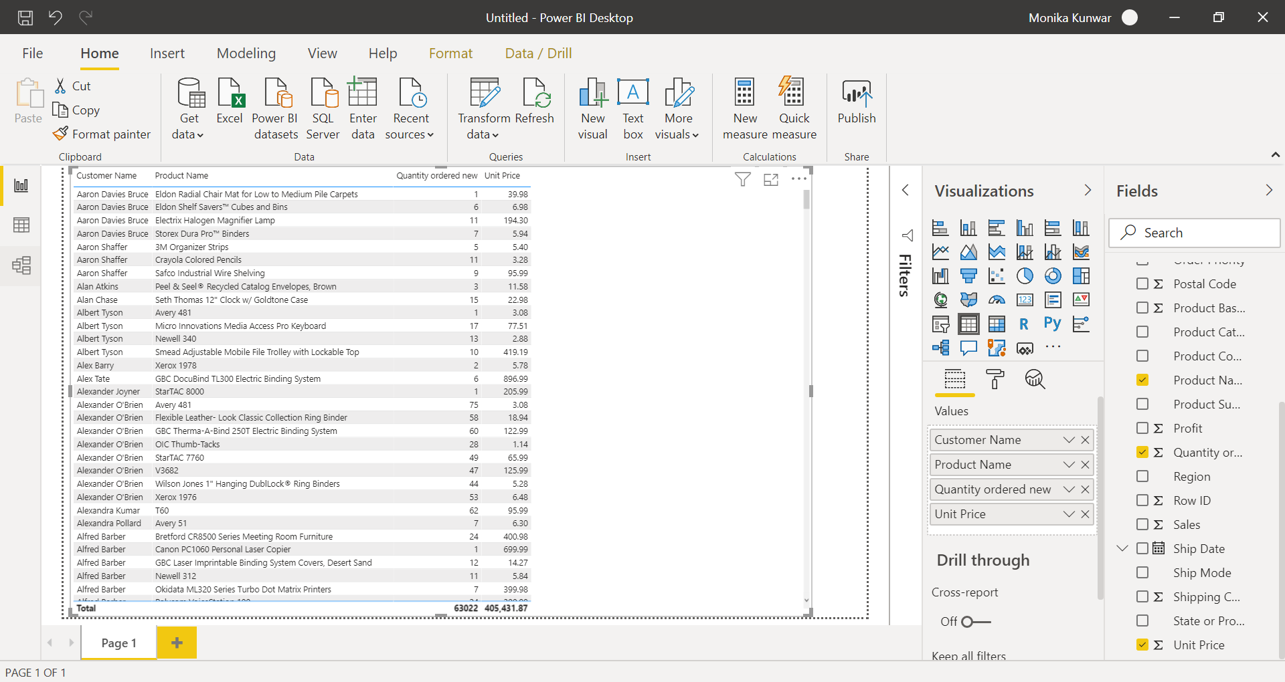
Report View

Slide 4
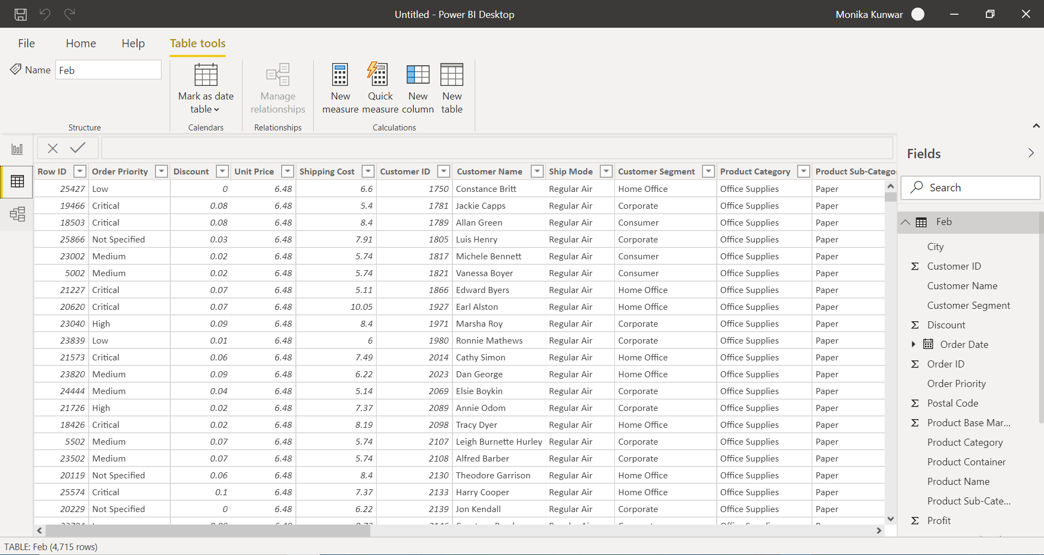
Data View

Slide 5
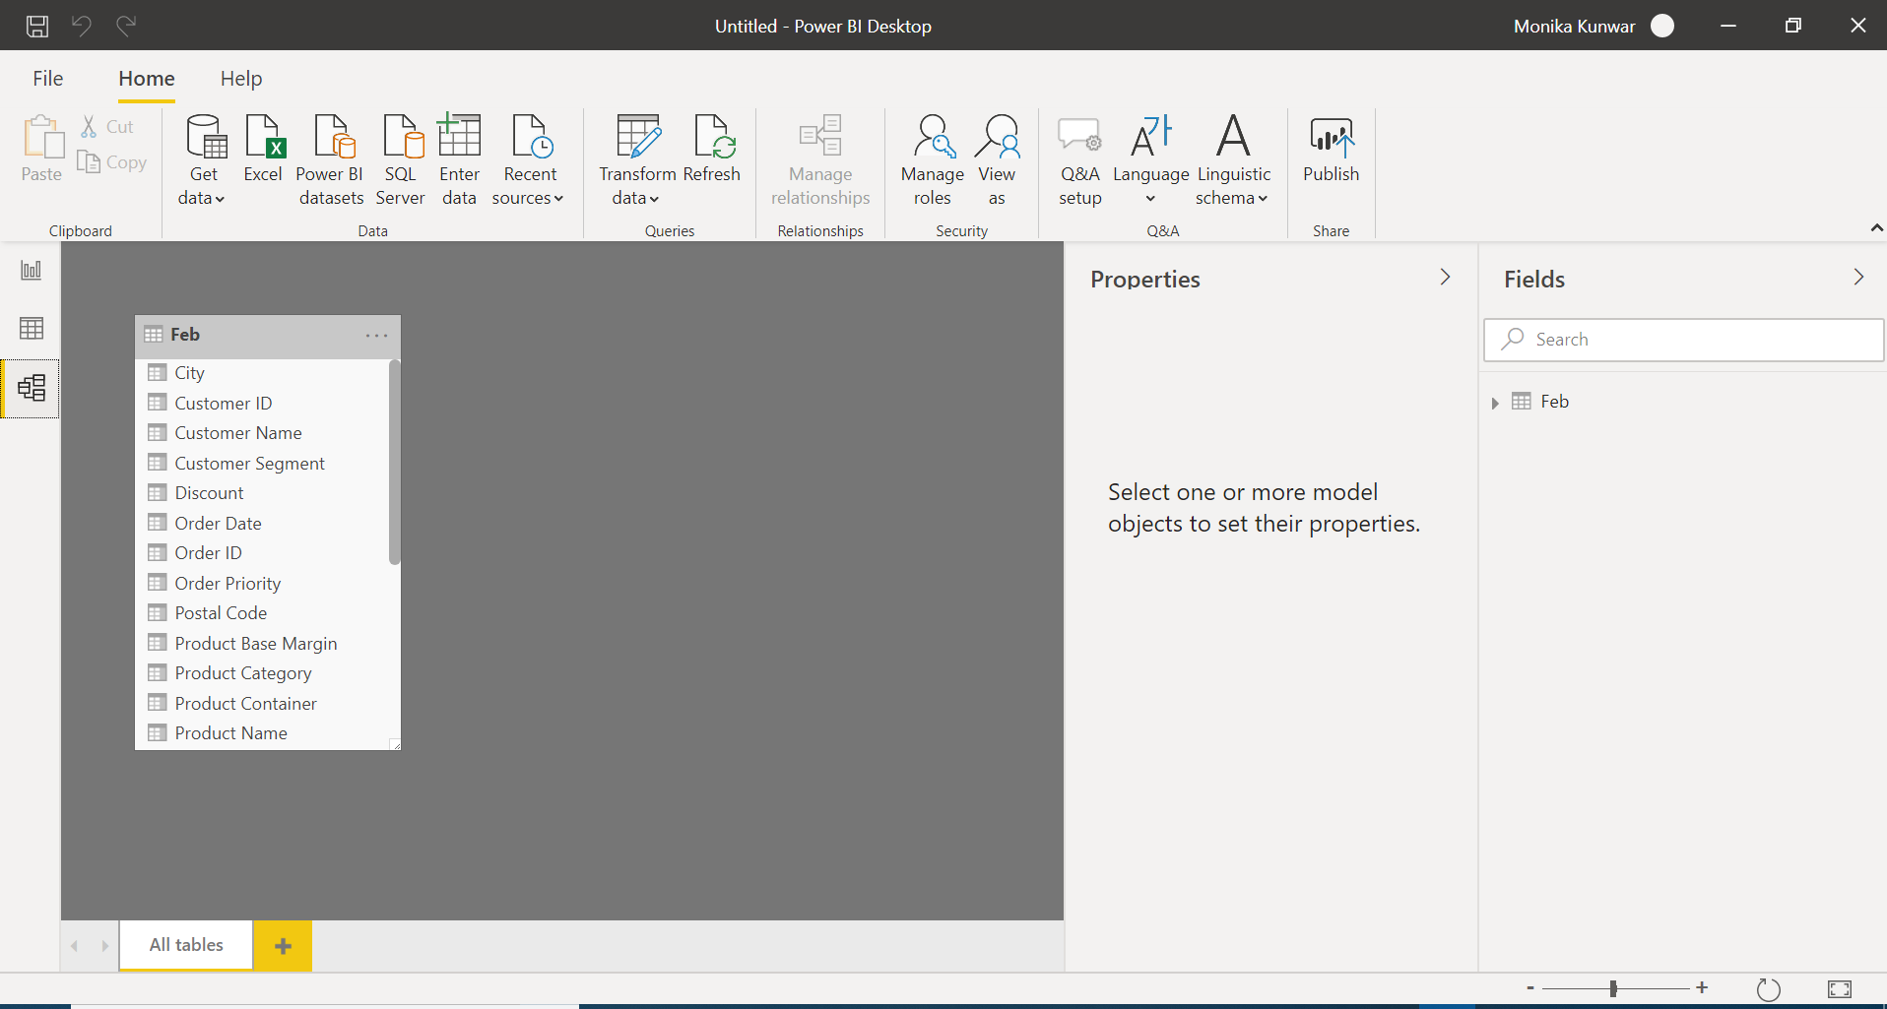
Model View

Slide 6
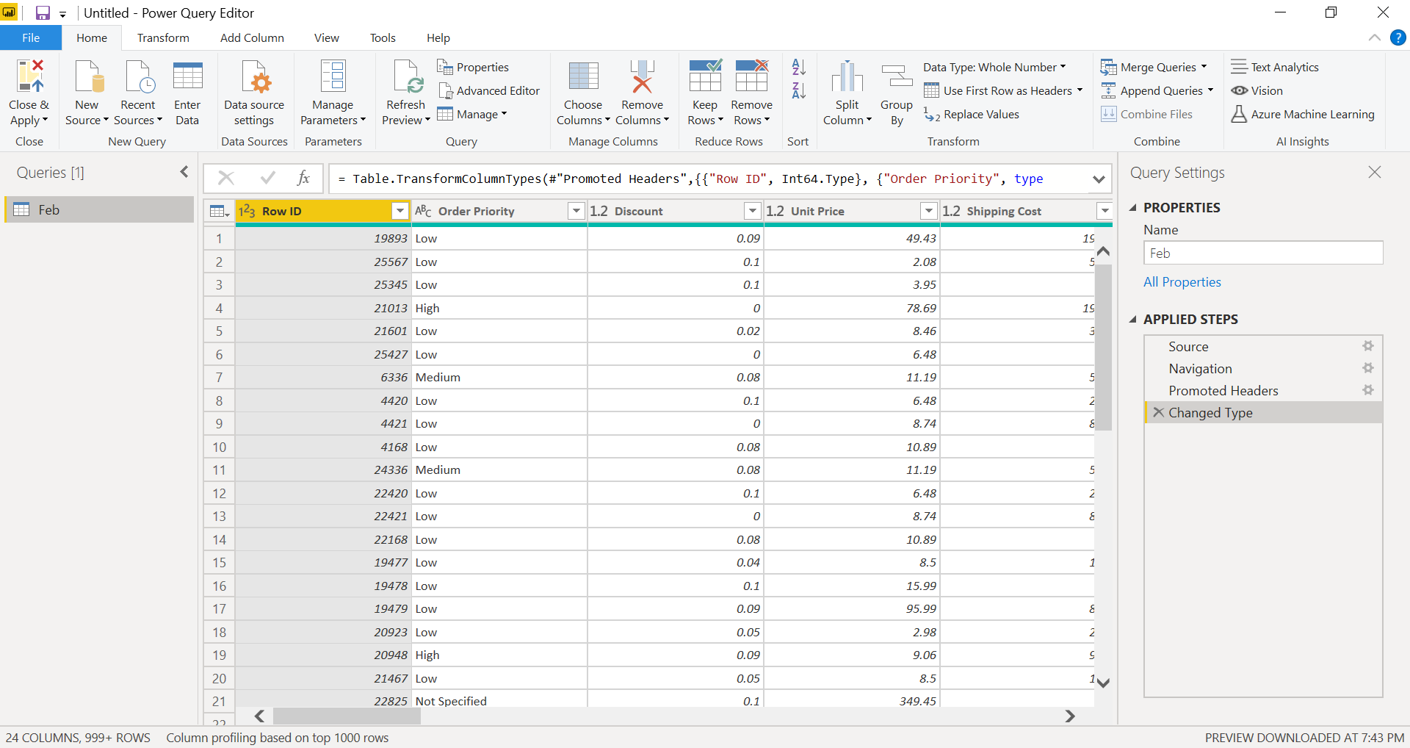
Power Query Editor

Slide 7
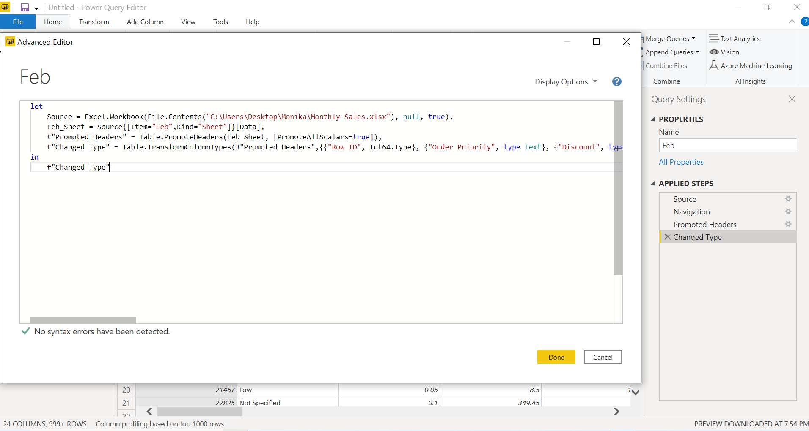
Advance Editor

Slide 8

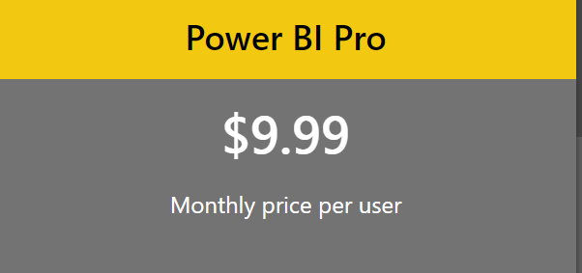
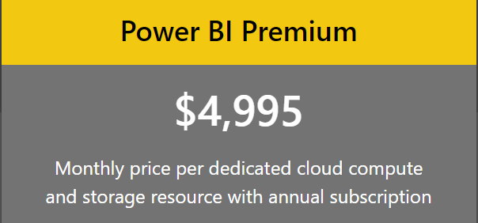
Power BI comes in three levels :
-Power BI Desktop
-Power BI Pro
-Power BI Premium.
The Desktop level is free for individual users, while the Pro plan costs $9.99 per user per month.
The Premium plan starts at $4,995 a month per dedicated cloud compute and storage resource.

